Slide 1
Software Requirements Analysis and Specification
C.Eng 491
Fall 2009-2010

Slide 2
Requirements Engineering
Requirements Engineering
Requirements Elicitation
Requirements Analysis
Requirements Specification
Requirements Verification
Requirements Management

Slide 3
Requirements Engineering
Stakeholder identification
Stakeholder interviews
Contract-style requirement lists
Measurable goals
Prototypes
Use cases

Slide 4
Requirements Engineering
Eliciting requirements: the task of communicating with customers and users to determine what their requirements are. This is sometimes also called requirements gathering.
Analyzing requirements: determining whether the stated requirements are unclear, incomplete, ambiguous, or contradictory, and then resolving these issues.
Recording requirements (specification): Requirements might be documented in various forms, such as natural-language documents, use cases, user stories, or process specifications.

Slide 5
Eliciting Requirements
Analysts can employ several techniques to elicit the requirements from the customer.
  interviews,
  focus groups (requirements workshops) and creating requirements lists.
  prototyping, and use cases.
  combination of these methods

Slide 6
Software Requirement Analysis
Determining the needs or conditions to meet for a new or altered product,
In other words, process of studying and analyzing the customer and the user/stakaholder needs to arrive at a definition of software reqiurements.
Requirements must be actionable, measurable, testable, related to identified business needs or opportunities, and defined to a level of detail sufficient for system design.
Requirements can be functional and non-functional.

Slide 7
Types of Requirements
Functional requirements
Performance requirements
  Speed, accuracy, frequency, throughput
External interface requirements
Design constraints
  Requirements are usually about “what”, this is a “how”.
Quality attributes
  i.e. reliability, portability, maintainability, supportability

Slide 8
Requirements vs. Design
Requirements | Design
Describe what will be delivered | Describe how it will be done³
Primary goal of analysis: UNDERSTANDING | Primary goal of design: OPTIMIZATION
There is more than one solution | There is only one (final) solution
Customer interested | Customer not interested (Most of the time) except for external

Slide 9
Software Quality Attributes
Correctness
Reliability
  Rating = 1 – (Num Errors/ Num LOC)
  Can be allocated to subsystems
Efficiency
Integrity
Usability
Survivability
Maintainability
Verifiability
Flexibility
Portability
Reusability
Interoperability
Expandability

Slide 10
Requirements Analysis
Defining Stakeholder profiles
Description - brief description of the stakeholder type
Type - Qualify s-h’s expertise, technical background, degree of sophistication
Responsibilities - List s-h’s key responsibilities with regard to the system being developed - why a stakeholder?
Success Criteria - How does the stakeholder define success? How rewarded?
Involvement - involved in the project in what way? Requirements reviewer, system tester, ...
Deliverables* - required by the stakeholder
Comments/Issues - Problems that interfere w/ success, etc.

Slide 11
Requirements Analysis
Defining User Profiles
Description - of the user type
Type - qualify expertise, technical background, degree of sophistication
Responsibilities - user’s key resp.’s w.r.t. system being developed
Success Criteria - how this user defines success? rewarded?
Involvement - How user involved in this project? what role?
Deliverables - Are there any deliverables the user produces? For whom?
Comments/Issues - Problems that interfere w/ success, etc.
  This includes trends that make the user’s job easier or harder

Slide 12
Requirements Analysis
Defining User Work Environment
Number of people involved in doing this now? Changing?
How long is a task cycle now? Changing?
Any unique environmental constraints: mobile, outdoors, in-flight, etc.
Which system platforms are in use today? future?
What other applications are in use? Need to integrate?

Slide 13
Requirements Analysis
Product Overview
Put the product in perspective to other related products and the user’s environment.
Independent?
Component of a larger system?
How do the subsystems interact with this?
Known interfaces between them and this component?
Block diagram

Slide 14
Requirements Analysis
Other Product Requirements
hardware platform requirements --
system requirements -- supported host o.s.’s, peripherals, companion software
environmental requirements -- temperature, shock, humidity, radiation, usage conditions, resource availability, maintenance issues, type of error recovery
applicable standards -- legal, regulatory, communications

Slide 15
Software Requirement Specification
A software requirements specification (SRS) is a complete description of the behavior of the system to be developed
A document that clearly and precisely describes, each of the essential requirements of the software and the external interfaces.
  (functions, performance, design constraint, and quality attributes)
Each requirement is defined in such a way that its achievement is capable of being objectively verified by a prescribed method; for example inspection, demonstration, analysis, or test.²

Slide 16
Requirements Analysis
Fundamental Techniques (Views)
functional view
  hierarchy -→ function tree
  process → use cases
  information ow → data flow diagram (DFD)
data oriented view
  data structures → data dictionary (DD), syntax diagram, Jackson diagram
  relations between entities → entity relationship diagram (ER)
object-oriented view
  class structure → class diagram

Slide 17
Requirements Analysis
algorithmic view
  control structures
  pseudo code, structogram, flow diagram, Jackson diagram
  conditions → rules, decision table
state-oriented view
  state machines
  Petri nets
  sequence charts

Slide 18
Use Case
use case is a description of a system’s behavior as it responds to a request that originates from outside of that system.
it describes "who" can do "what" with the system in question

Slide 19
Use Case Diagram
A use case diagram
  in the Unified Modeling Language (UML)
  a type of behavioral diagram defined by and created from a Use-case analysis.
  Its purpose is to present a graphical overview of the functionality provided by a system in terms of actors, their goals (represented as use cases), and any dependencies between those use cases.
The main purpose
  to show what system functions are performed for which actor.
  Roles of the actors in the system can be depicted.

Slide 20
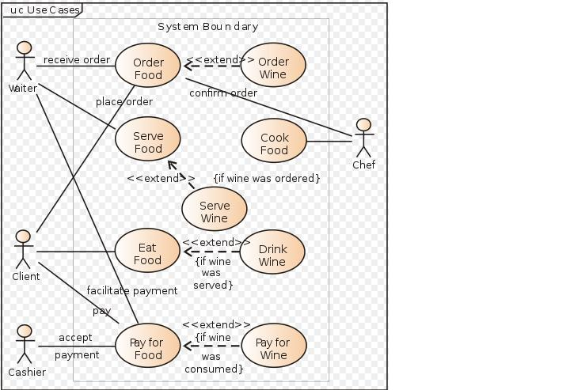
Use Case Diagram

Slide 21
Data Flow Diagram (DFD)
graphical representation of data ow (classical technique)
nodes:
  function → labeled circle
  store name → between two horizontal lines
  interface to environment → labeled rectangle
directed edges: represent data flow
properties of DFDs
  easy to create
  easy to read and understand

Slide 22
Data Dictionary
A data dictionary is a collection of data about data.
It maintains information about the definition, structure, and use of each data element that an organization uses.

Slide 23
Software requirements specification
Functional and Non-functional SRS
IEEE 830-1998.

Slide 24
IEEE Std 830-1998 IEEE Recommended Practice for Software Requirements Specifications -Description
Abstract: The content and qualities of a good software requirementsspecification (SRS) are described and several sample SRS outlines are presented. This recommended practice is aimed at specifying requirements of software to be developed but also can be applied to assist in the selection of in-house and commercial software products. Guidelines for compliance with 12207.1-1997 are also provided.
Keywords: contract, customer, prototyping, software requirements specification, supplier, system requirements specifications

Slide 25
SRS
Customer Requirements
Functional Requirements
Non-functional Requirements
Performance Requirements
Design Requirements
Derived Requirements
Allocated Requirements

